Slide 1

IBM Maximo Real Estate and Facilities the evolution of TRIRIGA
Notes:
This file is updated regularly. Always grab the latest version at:
https://ibm.seismic.com/Link/Content/DCGFbH76Hch2QGmGP262VBTmP37V

Slide 2


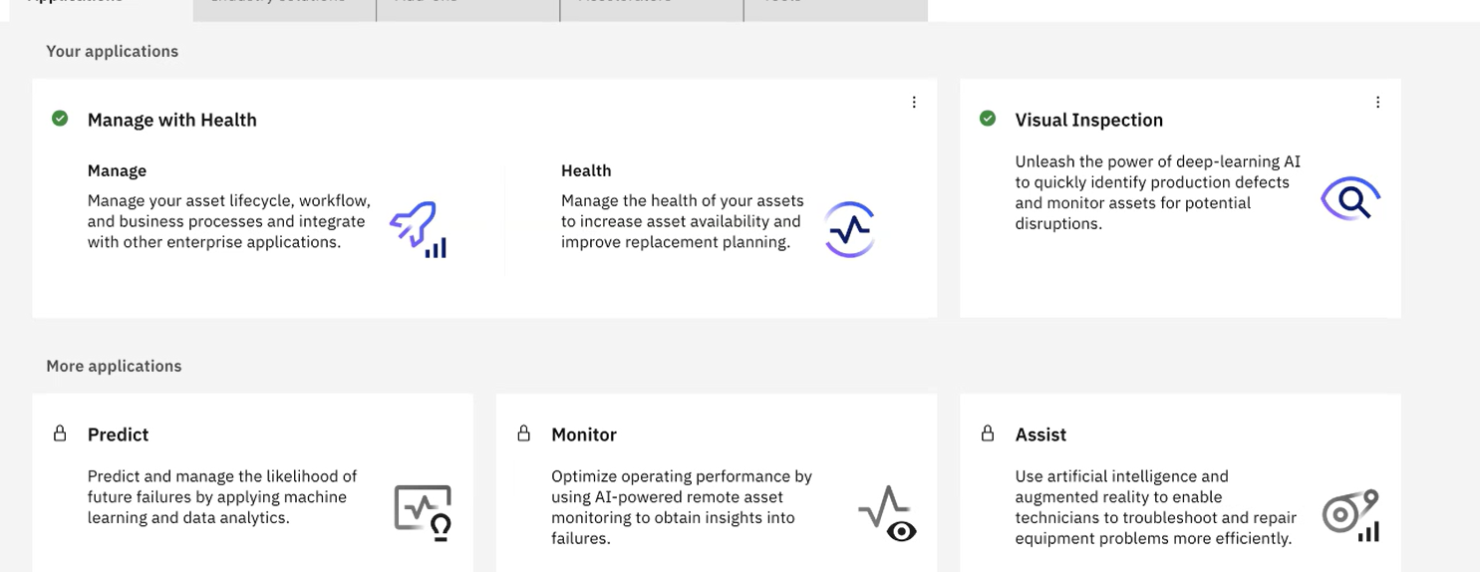




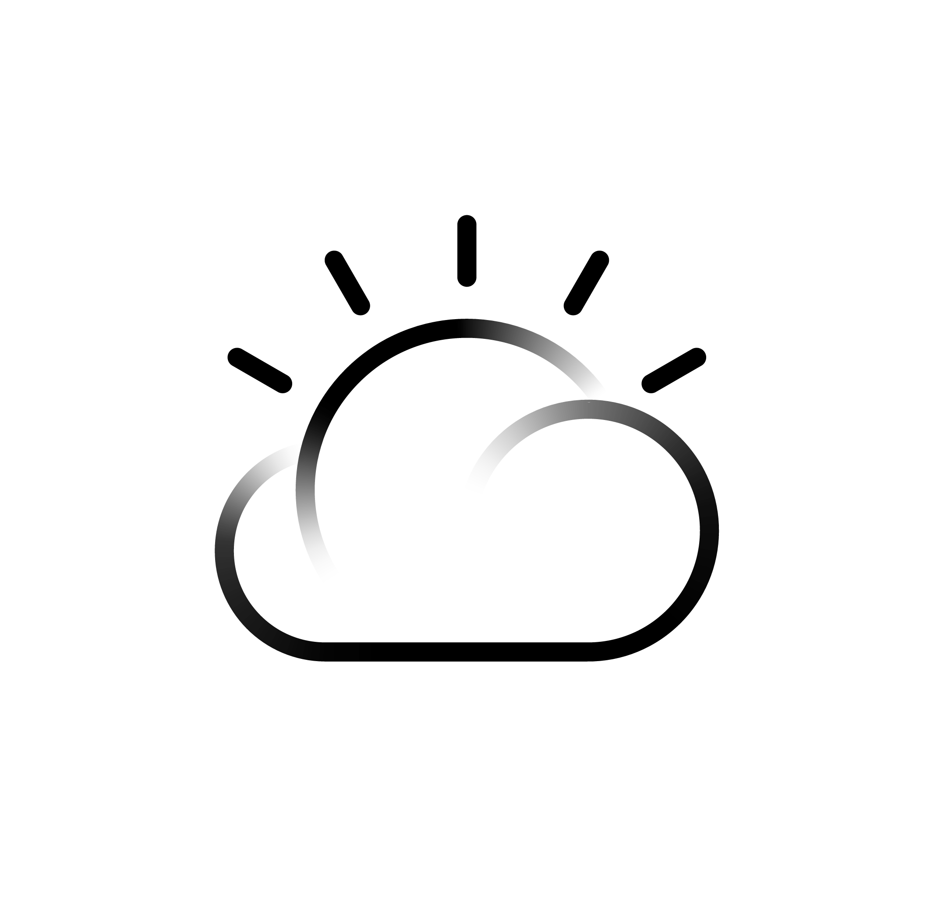

Maximo Application Suite
Manage
Intelligent Asset Management
Real Estate & Facilities
Intelligent Asset Management
Best-of-class capabilities to provide complete view of your assets addressing the needs of key personas in your organization.
Monitor
Monitor and Detect Anomalies
Health
360 View of Assets
Predict
Predictive Failures
Visual Inspection
AI-Powered Insights
Technicians
Technician Supervisor
Asset Maintenance Manager
Plant Manager
Fleet Manager
Operations Manager
Reliability Engineer
Quality Manager
Planners / Schedulers
Dispatchers
Storeroom Managers
Purchasing Managers
Facility Managers
Space Planner
Reservation Coordinator
Real Estate Strategist
Lease Administrator
Lease Accountant
Mobility and Dashboards | Intuitive and Modernized
Industry Solutions & Add-on’s | Accelerate time to value
Manage
Reliability Strategies
RE&F
Lease Accounting
Manage
Maximo IT
Manage
Health Safety and Environment
Manage
Scheduler Optimization
RE&F
Space Planning
Agents and Alerts | AI and Analytical Insights
IBM Cloud Pak for Data | Watson | App Connect | Cognos Analytics
Infrastructure Independent
Common Operating Environment
IBM Cloud
AWS
Azure
Google Cloud
Private
Edge
Systems
2
Notes:
KIM

Slide 3
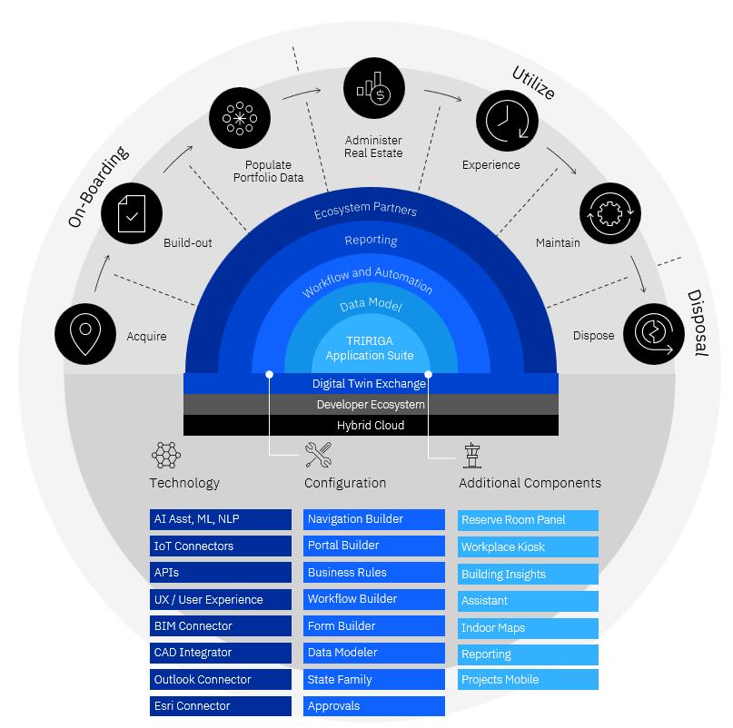
TRIRIGA is the leading enterprise solution to manage real estate portfolios and operations
TRIRIGA helps enterprises meet their operational needs, optimize costs, sustainability and the workplace experience across real estate lifecycles.
TRIRIGA integrates data and automates processes through the complex lifecycle of how companies
on-board facilities and the space they need
utilize that space for their employees, partners or customers
ultimately dispose of it
Notes:
IBM TRIRIGA is a market-leading integrated workplace management solution (IWMS) that provides a variety of capabilities related to facilities management. It integrates data and automates processes through the complex lifecycle of workplaces and facilities. It helps organizations manage and optimize their:
Workplace experience
Facility resource scheduling
Facility strategic planning
Transaction management
Lease accounting
Capital project management
Space management
Facility maintenance management
Facility sustainability management
Asset disposal
In short, TRIRIGA helps organizations control costs, optimize performance, and improve underperforming properties. Moreover, it can create an engaging experience for the workforce and add productivity to their day. TRIRIGA is able to do so by answering questions such as:
What action should be taken with an expiring lease?
Where are some opportunities to reduce organizational footprint without sacrificing occupant experience?
How can the floor plans be reconfigured based on changing needs?
TRIRIGA provides a platform for managing enterprise real estate throughout its entire lifecycle, from on-boarding new facilities to disposing of old ones as shown on the circular diagram on the right of this slide. It helps organizations make decisions about size, location, lease vs. purchase, and more. Additionally, it provides the operational tools necessary to manage and optimize facilities on a daily or weekly basis.
TRIRIGA uses real-time insights infused with artificial intelligence (AI) to support dynamic space planning. This can help to:
Ensure a safe return to the workplace with real-time occupancy insights
Allow occupants to easily make service requests, book rooms, and navigate seamlessly in new, unfamiliar or redesigned spaces
Reduce the overall real estate costs by right-sizing an enterprise’s real-estate portfolio
Increase efficiency of lease administration and accounting, capital projects, and maintenance efforts
Reduce the amount of technical proficiency required at a local level. Clients no longer need boots on the ground to have technical expertise; instead, they can better administer and manage issues from a centralized location.
Acronyms:
NLP: Natural Language Processing
API: Application Programming Interface
ML/AI: Machine Learning / Artificial Intelligence

Slide 4
Strategic Real Estate Asset Management can extend beyond IWMS to manage complex business operations
Lease
Envizi
Environmental goals and reporting
Carbon emissions and energy reporting
Capture activity data (energy, water, waste) or CO² data from suppliers
Integrated Workplace Management (IWMS)
TRIRIGA
Routine requests (cleaning, facility repairs, food orders, moves, etc.)
Space
Sustainability
TRIRIGA
Location-based hierarchy
Request portal is the “front door”
Full OOB complement of core real estate capabilities
End-user tools for workplace experience
Configurable to align to user business processes
Maximo Application Suite
Complex equipment failures
Predictive and condition-based maintenance
Automated visual inspection
Projects
Maintenance
Notes:
IBM TRIRIGA offers out-of-the box (OOB) capability to deliver the core functions of Corporate Real Estate and Facilities Management.
The five main areas in which TRIRIGA’s capabilities optimize enterprise spaces throughout its lifecycle are:
Lease accounting: The “devil is in the details” when it comes to managing leases across real estate and asset portfolios. TRIRGA helps businesses conform to lease accounting standards, ensuring accurate financial reporting, adherence to lease requirements, and managing payments.
Sustainability: TRIRIGA helps to manage buildings in a way that encourages sustainability through the entire real estate lifecycle — from acquisition to disposal — without sacrificing operational resiliency or occupant experience. It helps to enable energy efficiency with green leases, reduce waste and energy usage by integrating the right data, extend asset life through improved maintenance, and detect and dispose of inefficient and wasteful spaces.
Operations and maintenance: Building maintenance and repairs are inevitable — TRIRIGA helps to better understand the condition of enterprise buildings, and the assets that reside within. This enables clients to better optimize repairs and maintenance projects accordingly.
Capital projects and planning: Capital projects have many moving pieces that are too cumbersome to be handled by manual or spreadsheet solutions. TRIRIGA helps cut through the complexity, with tools to help quickly and easily identify priorities, plan, secure budget, select vendors, and manage contracts.
Space optimization: Optimizing building space helps to improve the bottom line. This further enables increased productivity and engagement of occupants. TRIRIGA offers comprehensive reservation tools to reserve flexible spaces, as well as to ensure that they have all the amenities that they require.
The capabilities of TRIRIGA can be enhanced by combining with two other best-in-class applications: IBM Maximo Application Suite and IBM Envizi. This helps IBM TRIRIGA to extend beyond traditional Integrated workplace management systems (IWMS) to manage complex business operations.
A user can initiate a request using TRIRIGA’s “Request” portal. This works as a “front door” to initiate requests of any kind. Depending on the nature of the request, it is delegated to the appropriate application (either Maximo or Envizi) downstream.
For environmental sustainability, TRIRIGA’s capabilities are enhanced through IBM Envizi for goal setting and comprehensive reporting. For equipment maintenance, TRIRIGA is elevated by IBM Maximo Application Suite. Maximo can handle complex predictive and condition-based maintenance, and can help decide where it makes sense to automate AI-powered visual inspections.
All three of these products work together through connectors and integration to provide a complete solution.
Glossary:
Envizi is an IBM Company and market leader in data and analytics software for sustainability and energy. It can be used as a decision support tool to unlock the insights that organizations need at every step of its decarbonization journey. More information can be found here: https://www.ibm.com/products/envizi.
Maximo Application Suite is a single, integrated application platform that uses Artificial Intelligence (AI), Internet of Things (IoT), and analytics to optimize performance, extend asset lifecycles, and reduce operational downtime and costs. More information can be found here: https://www.ibm.com/products/maximo.
Wayfinding refers to information systems that guide people through a physical environment and enhance their understanding and experience of the space they are in. Wayfinding is particularly important in complex-to-navigate environments. As architectural environments become more complicated, people need visual cues such as maps, directions, and symbols to help guide them to their destinations. In these often high-stress environments, effective wayfinding systems contribute to a sense of well-being, safety, and security.
Workplace flexibility is an arrangement between employees and employers in which both parties agree on when, where, and how the employee will work to meet the organization’s needs. Flexibility can be formal and officially approved through Human Resources (HR) policies, or informal and available on a discretionary basis.

Slide 5
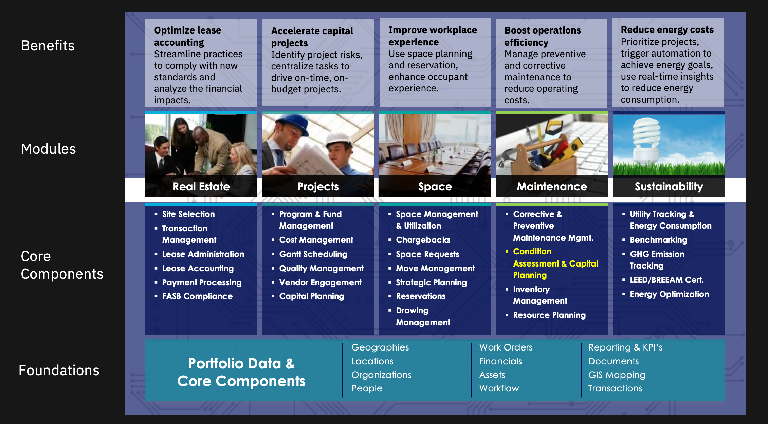
Portfolios of IBM TRIRIGA

Slide 6
Transitioning to ALM introduces new possibilities to extend sustainability, maintenance and asset management capabilities
Real Estate & Facilities
Asset Management
Environmental Solutions
On-Boarding
Utilize
Disposal
Acquire
Build-out
Populate Portfolio Data
Administer Real Estate
Experience
Maintain
Dispose
Portfolio assessment
Identify requirements
Search for potential locations
Compare potential locations
Justify lease or purchase decision
Exercise lease options
Execute purchases
Estimate projects
Prioritize and execute environmental improvement projects
Establish and manage schedules
Manage proposals
Manage commitments and payments
Manage project risks, changes and progress
Plan and instrument IoT technology
Track carbon reduction to project progress
Project close-out
Populate location hierarchy
Load floorplans from CAD/BIM
Load assets
Manage space details
Manage space allocations
Assign seats
Synthesize utility and BMS data sources
Ingest energy, waste and water data for reporting and KPIs
Convert utility and fuel consumption data to carbon emissions
Abstract new leases
Meet lease accounting regulations
Manage lease financials
Track critical dates
Comply with lease terms
Renegotiate leases
Execute property management on leased and owned properties
Track supplier sustainability data
Aggregate operational KPIs to dashboards
ESG reporting and risk management
Submit facility rating data to agencies
Measure real time space use
Validate space use
Initiate and manage moves
Employee workplace services portal
Reserve work and meeting space
Indoor wayfinding
Locate colleagues
Remote asset monitoring and utilization
Health analytics for facility use and assets
HSE management
Manage work orders and service requests
Manage planned, predictive and condition maintenance
Maintain parts inventory
Warranty management
Plan for facility component lifecycle
Manage facility condition index
Plan and execute local projects
Identify environmental improvement projects
Track utility consumption
Physical and visual inspections
Mobile technician WS
Portfolio reassessment
Identify space and facilities to relinquish
Model space scenarios
Implement moves
Identify excess space for disposal
Define and compare downsize scenarios
Decide and execute
Site remediation
Prepare site to sell or return
Retire assets
Report carbon savings from consolidation
Notes:
Managing the space an enterprise needs has a distinct lifecycle. This includes on-boarding new space, using and managing it and ultimately disposing of space when its no longer needed. All enterprises that own or lease facilities are already doing all these process steps in one form or another. The more of these processes and data that are integrated and accessible across this lifecycle the better operational performance and reduced cost and enterprise may realize.
This is work that all are already doing. Its not uncommon for large enterprises to have 20, 30 or even 40 systems that executed this work. That includes spreadsheets, e-mail and paper files. All of it can be done with TRIRIGA. These use all represent out-of-box capabilities that don’t require customization. They can be configured to meet customer needs.

Slide 7
TRIRIGA manages real estate throughout its lifecycle
On-Boarding
Utilize
Disposal
Acquire
Build-out
Populate Portfolio Data
Administer Real Estate
Experience
Maintain
Dispose
Portfolio assessment
Identify requirements
Build transaction plans
Search and compare potential locations
Justify lease or purchase decision
Exercise lease options
Execute purchases
Estimate projects
Prioritize and execute environmental improvement projects
Establish and manage schedules
Manage proposals
Manage commitments and payments
Manage project risks, changes and progress
Project close-out
Populate location hierarchy
Load floorplans from CAD/BIM
Load assets
Manage space details
Manage space allocations
Assign seats
Synthesize utility and BMS data sources
Abstract new leases
Meet lease accounting regulations
Manage monthly lease financials
Track critical dates
Comply with lease terms
Renegotiate leases
Property mgt of leased and owned properties
Measure real time space use
Validate space use
Initiate and manage moves
Employee workplace services portal
Reserve work and meeting space
Indoor wayfinding
Locate colleagues
Manage work orders and service requests
Manage planned maintenance
Maintain parts inventory
Warranty management
Plan for facility component lifecycle
Manage facility condition index
Plan and execute local projects
Identify environmental improvement projects
Track utility consumption
Portfolio assessment
Identify space and facilities to relinquish
Model space scenarios
Implement moves
Identify excess space for disposal
Define and compare downsize scenarios
Decide and execute
Site remediation
Prepare site to sell or return
…all capabilities are available off-the-shelf and are aligned to business processes through configuration
Notes:
Managing the space an enterprise needs has a distinct lifecycle. This includes on-boarding new space, using and managing it and ultimately disposing of space when its no longer needed. All enterprises that own or lease facilities are already doing all these process steps in one form or another. The more of these processes and data that are integrated and accessible across this lifecycle the better operational performance and reduced cost and enterprise may realize.
This is work that all are already doing. Its not uncommon for large enterprises to have 20, 30 or even 40 systems that executed this work. That includes spreadsheets, e-mail and paper files. All of it can be done with TRIRIGA. These use all represent out-of-box capabilities that don’t require customization. They can be configured to meet customer needs.

Slide 8
MAS REF AppPoint consumption tiers
User has entitlement to use all apps/components in assigned tier | Acquire / Dispose | Build-out | Populate Portfolio Data | Administer Real Estate | Experience | Maintain
Self-Service authorized user / 0 AppPoints concurrent user / 0 AppPoints | Service Requests News Real Estate requests | Service Requests News Project requests |  | Service Requests News Real Estate requests | Service Requests Locate News Move requests | Service Requests News Product requests
Limited authorized user / 2 AppPoints concurrent user / 5 AppPoints | Self-Service + Reports, metrics Approvals Contract requests Offline forms | Self-Service + Reports, metrics Approvals Vendor bid resp Change requests Project tasks Offline forms | Self-Service + Floorplan reports | Self-Service + Reports, metrics Approvals Contract requests Offline forms | Self-Service + Reports, metrics Approvals Move/reserve tasks Space assessment Offline forms | Self-Service + Reports, metrics Approvals Work task exec Contact center Offline forms
Base authorized user / 3 AppPoints concurrent user / 10 AppPoints | Limited + Advanced scenarios Transaction mgt Portfolio planning | Limited + Cost mgt Schedule mgt Purchase order approvals Procurement mgt Program mgt Facility condition assessment | Limited + Drawing/model mgt Energy Star benchmarking | Limited + RE lease admin AR tenant tracking Payment processing Generate journal entries | Limited + Space planning Move mgt Reserve coordination Facility project mgt Strategic planning | Limited + FCA inspections O&M mgt Model mgt Asset lease admin Facility project mgt Facility condition assessment Opportunity analysis Work req from SNMP alerts Energy/waste log mgt Utility Invoice tracking
Premium authorized user / 5 AppPoints concurrent user / 15 AppPoints
Reserve + Room Panel install user
Base +
Configuration Tools
Tier 1/ 20 AppPoints – < 10K reserve users
Tier 2/ 120 AppPoints – 10K – 100K reserve users
Tier 3/ 200 AppPoints – > 100K reserve users
Self-Service +
Room / Desk Reservations
Note: User licensing is the same in MAS SaaS however, Lease and Reserve usage consumption in SaaS is metered in a different manner.
8

Slide 9

These embedded building blocks provide powerful capabilities to enhance out-of-box use cases and enable complex business processes
Entry point for users to initiate a wide range of requests
Pre-defined process steps that may be commonly utilized
Action Items requiring user approval
Activities with a defined start, end, resource, status, and sometimes cost
Request
Templates
Approvals
Tasks &
Projects
Specify parameters for request processing and routing through workflow engine
Pauses in workflow processes that require a user action
Service Matrix
Dashboard
Action Items
External systems of record to pull data from (ERP, HR, Financial)
Complex business logic and rules engine
Superset of entity lifecycle and state transitions
Entity definitions, attributes and relationships
Integration
Workflow Engine
State Family
Data Model
Notes:
TRIRIGA differentiates through its ability to automate business processes out-of-the-box and be further configured. This slide shows some of the different options available to automate a business process flow. Each of these features can be tailored to fit a unique business use case. These building blocks provide powerful capabilities to enable complex business processes:
Request: Entry point for users to initiate a wide range of requests
Templates: Pre-denied process steps that may be commonly utilized
Approvals: Action items requiring user approval
Tasks and projects: Activities with a defined start, end, resource, status, and sometimes cost
Service matrix: Specify parameters for request processing and routing through workflow engine
Action items: Pauses in work workflow processes that require a user action
Integration: External systems of record to pull data from. This includes Enterprise Resource Planning (ERP) tools, Human Resources (HR) tools, and Financial tools.
Workflow engine: Complex business logic and rules engine
State family: Superset of entity lifecycle and state transitions
Data model: Entity definitions, attributes, and relationships
Acronym:
ERP : Enterprise Resource Planning

Slide 10
TRIRIGA offers a highly configurable application platform
Attributes
Associations
Data State
Events & Transitions
Data Modeler
TRIRIGA is built on an integrated application platform with a comprehensive palette of builder tools
TRIRIGA’s functionality is enabled through these tools providing implementers with the ability to extend the system in response to changing business requirements as needed.
“This is a custom market looking for a productized solution.”
Competitive Analyst Quote
Workflow
Service Matrix
Approvals
Action Items
Process Automation
Integration
UI Builder
Presentations of Portal Content
Navigation
Reports & Dashboards
Forms
Perceptive Apps
Notes:
The earlier building block slide (titled: These embedded building blocks provide powerful……..) showed a detailed view of the platform automation building blocks. This slide brings that discussion back up to a slightly higher level to summarize the configurable platform benefits across automation and User interface (UI) / User Experience (UX).
IBM TRIRIGA is built on an integrated application platform that comes with a wide range of builder tools. These tools enable TRIRIGA’s functionality and provide implementers the ability to extend the system as business requirements change. Though many enterprises say they want simple out-of-box solutions to manage their real estate portfolios, they often have complex processes that are essential to their business. Therefore, it is important for solutions to be able to be configured to work with these processes, so that work isn't disrupted.
TRIRIGA provides organizations with graphical tools to rapidly configure applications and extend the use and value of existing systems. This allows users to create customized applications tailored for their business and allows them to focus on the functionality of the application rather than the technical details. This separation usually results in a better fit for business needs. Furthermore, many users only need a few weeks of training to be able to use the platform to build applications. This eases the burden on businesses, as they do not need to hire programmers to build custom applications.
The three main parts of TRIRIGA that users can customize are Data Modeler, Workflow and User interface (UI) builder:
Data Modeler: As the name implies, Data Modeler is responsible for designing the data model for the application that represents the client business. This includes defining the data attributes, associations, data events, and transitions. For example, the data model for a software application that tracks employee attendance would include attributes for employee name, employee ID, date, time in to work, time out to work, and total hours worked. These associations would define the relationships between employees and their attendance data. The events and transitions would define the sequence of events that occur when an employee clocks in or out.
Workflow: A Workflow is responsible for defining the sequence of steps that need to be executed in order to complete a task. This includes defining the service matrix, approvals, action items, process automation, and integration. For example, a workflow can be used to automatically create a task when an email arrives in a certain mailbox. Tasks may be assigned to specific individuals or groups for completion, and action items can be inserted before the process can continue. Users can also create approval requirements from one or more individuals or groups before the process can be finally completed. For example, a manager needs to sign off on paid time off (PTO) whenever an employee enters a time-off request in the system.
User Interface (UI) Builder: The UI Builder is responsible for designing the user interface for a software application. This includes defining the navigation, reports and dashboards, and forms.
A detailed description of TRIRIGA application platform builder tools can be found at https://www.ibm.com/docs/en/SSHEB3_4.0/pdf/pdf_tap_appbuild.pdf.

Slide 11
TRIRIGA provides several integration methods
Integration
IBM TRIRIGA Offerings
Acquire
Build-out
Populate Portfolio Data
Administer Real Estate
Experience
Maintain
Dispose
Centralized Database and Document Repository
IBM TRIRIGA Interoperability
Integration Methods
OSLC / REST Web Services
CBA; ClassLoader; Servlet Proxy
Document Manager
Integration Objects
IBM TRIRIGA DataConnect
IBM TRIRIGA
Offline
IBM TRIRIGA Data Integrator
JSON Based
SOAP XML Based
Java Based
Metadata
Driven
Workflow
Based
Excel
Based
Text
Based
ESB, Point to Point
CMIS Connector
Staging Areas –Database Tables
OOB Connector
Custom
AutoCAD
Revit (BIM)
Exchange
Outlook
Cisco
ENERGY STAR
Oracle
WFM
External Systems
Document
Mgmt.
Active
Directory
GIS
OSCRE
MicroStation
Autodesk Forge
Excel
Project
Esri Apple Indoor Maps
SAP
CRM

Slide 12
Migration from TRIRIGA to MAS RE&F
TRIRIGA
Maximo Application Suite
IBM will deliver a tool to enable migration from traditional TRIRIGA and TRIRIGA Application Suite to MREF
Pre-requisites
TRIRIGA/TAS supported versions:
Platform: v5.0 & 4.5
Applications: v11.5+
Migration activities
Deploy Maximo Application Suite with Maximo Real Estate and Facilities
Take a backup of database and restore into MAS configured database
Configure migration tooling with MAS / MREF credentials
Migrate users and licenses using the migration tooling
Validate creation of user / license records in MAS Core via API
Generate report of activities or log during process
Apply any required patches (via the update container or tool) to the application
Test against a provided checklist for known “change” areas

Slide 13
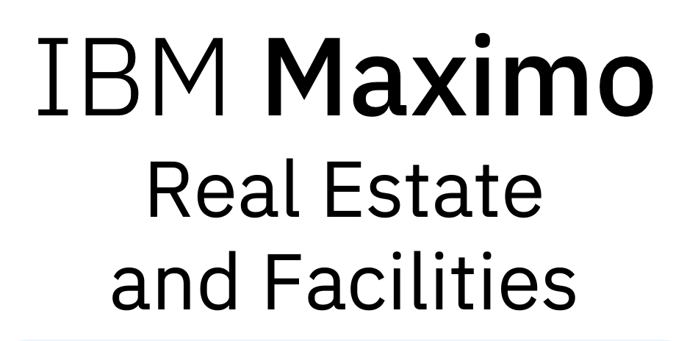
Migration To Real Estate and Facilities Process
Transition
(Optionally) move to new database vendor on source
Shutdown TRIRIGA
Backup database
Tooling coming in Q3 to support these activities
Installation
Create or identify OpenShift Cluster
Install pre-requisites (MAS Core, Foundation Services)
Procure or install required target database (OpenShift or outside)
Install Real Estate and Facilities
Restore source database into target database
Configuration
Obtain API Key from MAS Core
Obtain Database Credentials
Start Migration Tool Container
Configure Database Credentials
Configure API Key for MAS Core
Execution
Migration Tool Connects To Database
Migration Tool Reads Users and Licences
Migration Tool Connects To MAS Core via API
Migration Tool Creates Users and Assigns Licences via API
Migration Tool Adds Application Patches via Update Container
Validation
Migration Tool Logs Each User Creation
Migration Logs Each Licence Assignment
Migration Tool Connects To MAS Core via API
Migration Tool Queries and Validates User Created via API
Migration Tool Queries and Validates Licence Assigned via API

Slide 14
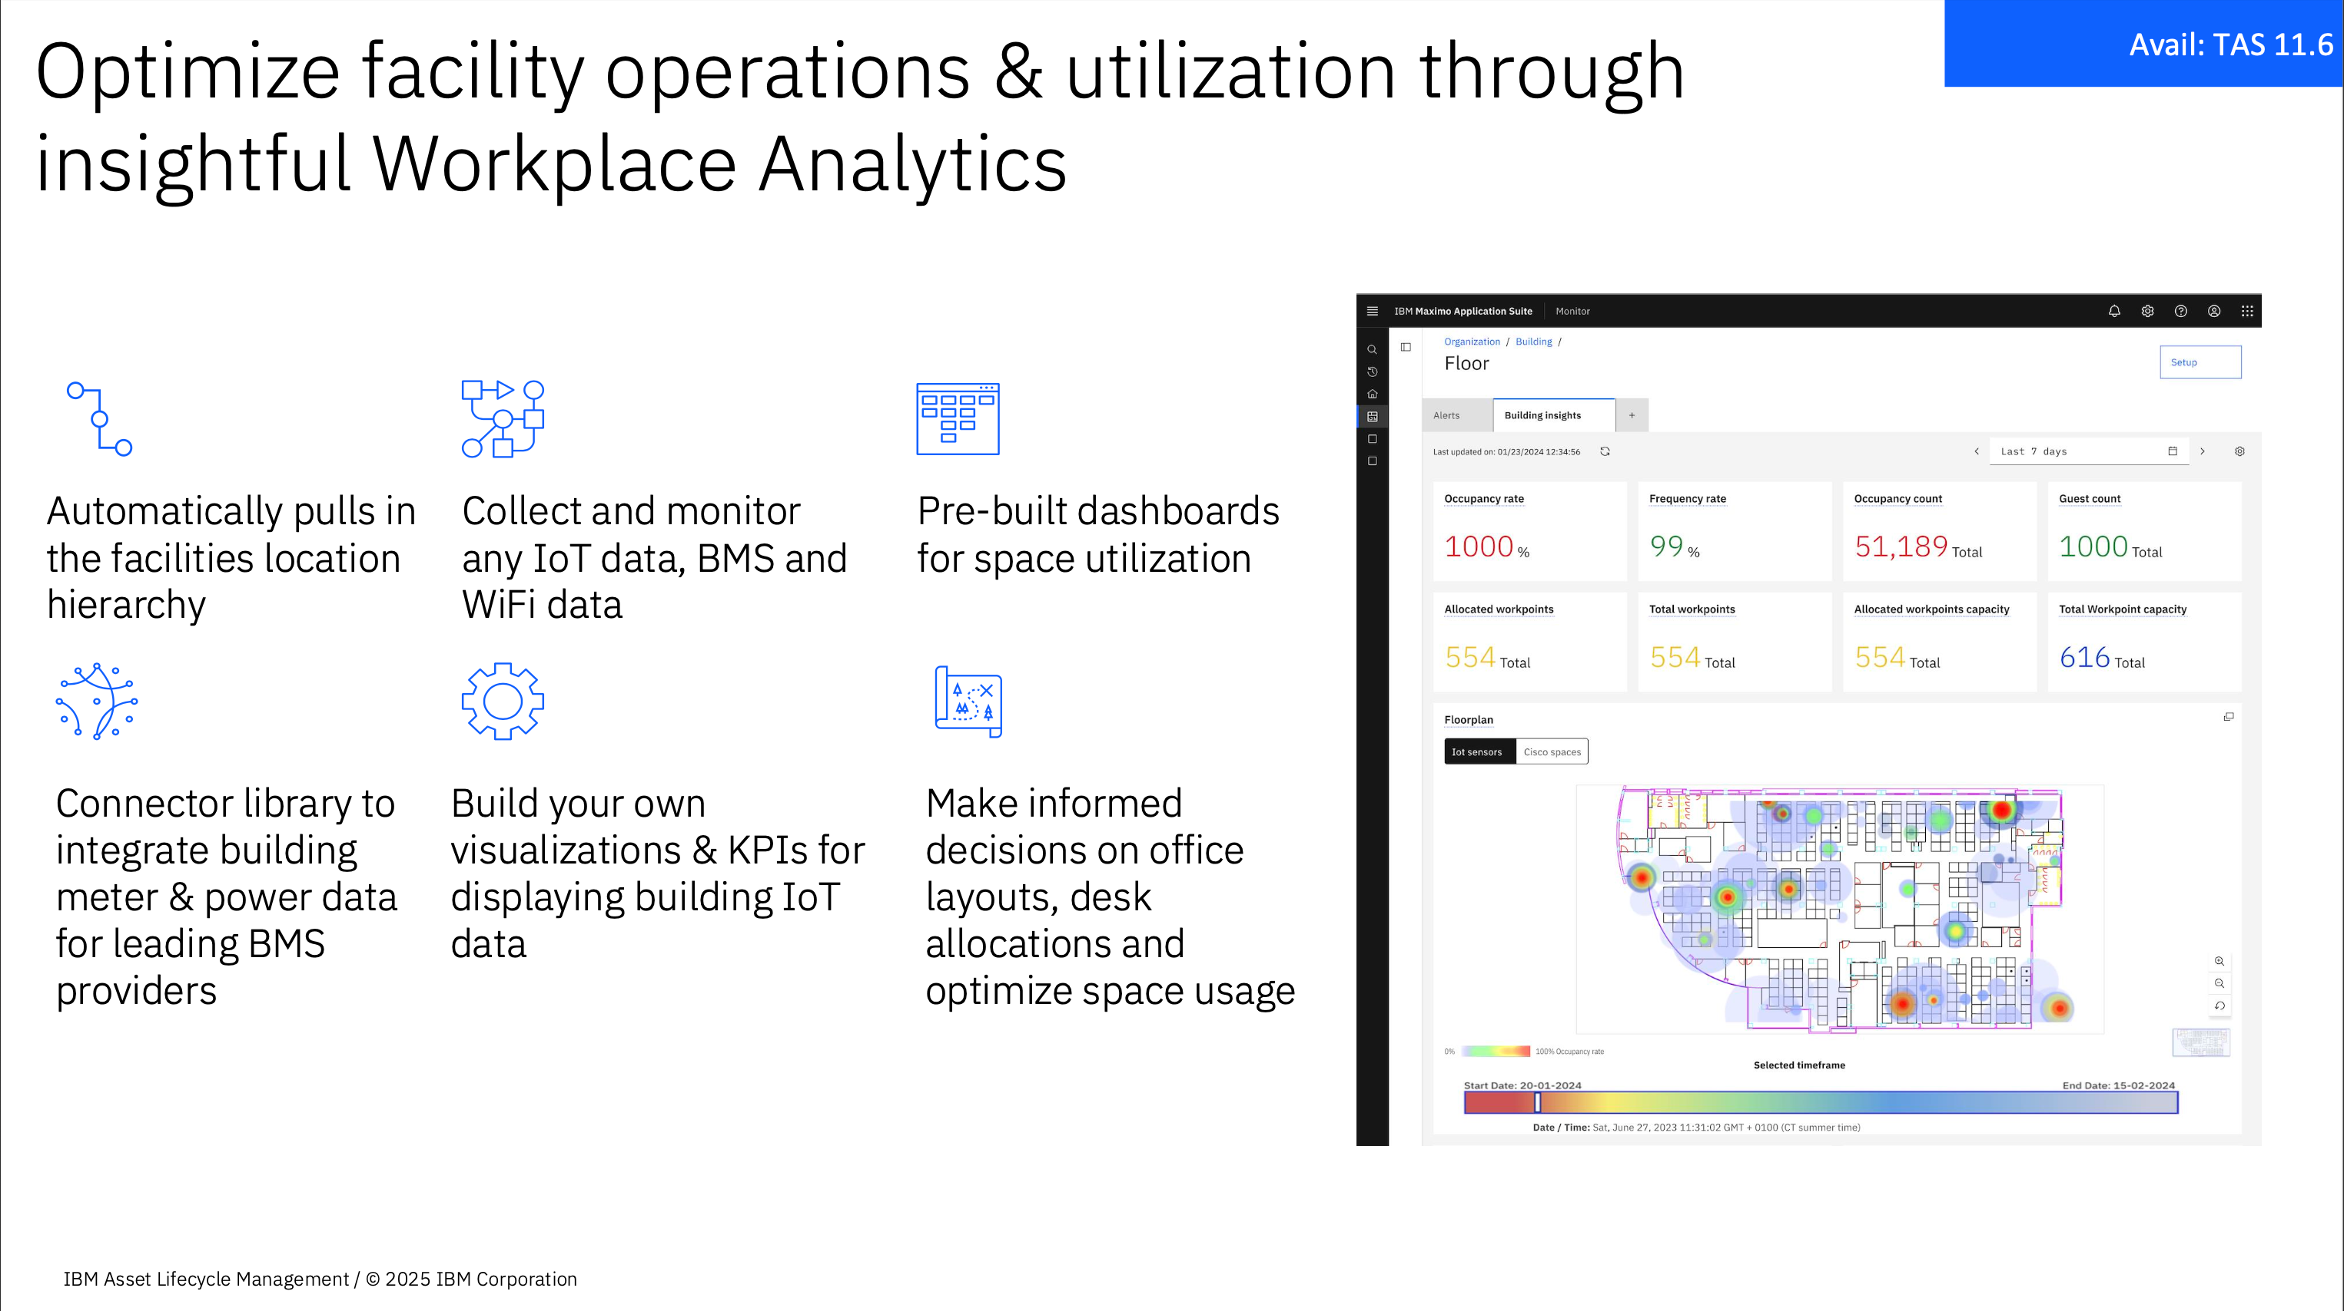

Slide 15
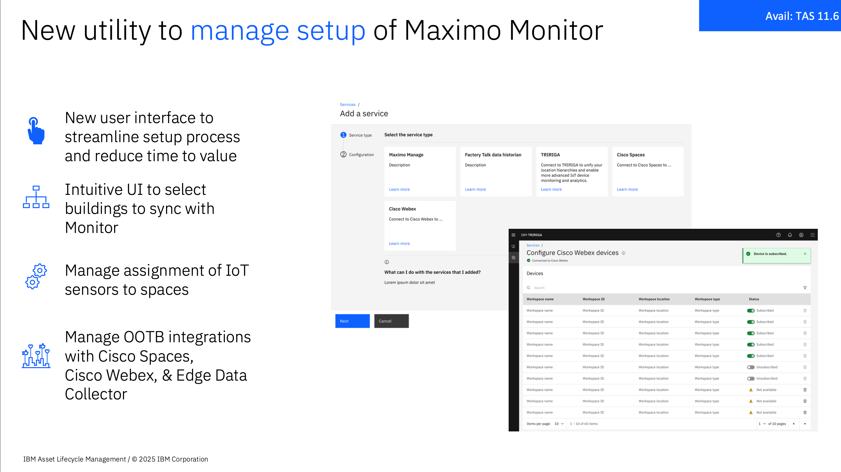

Slide 16
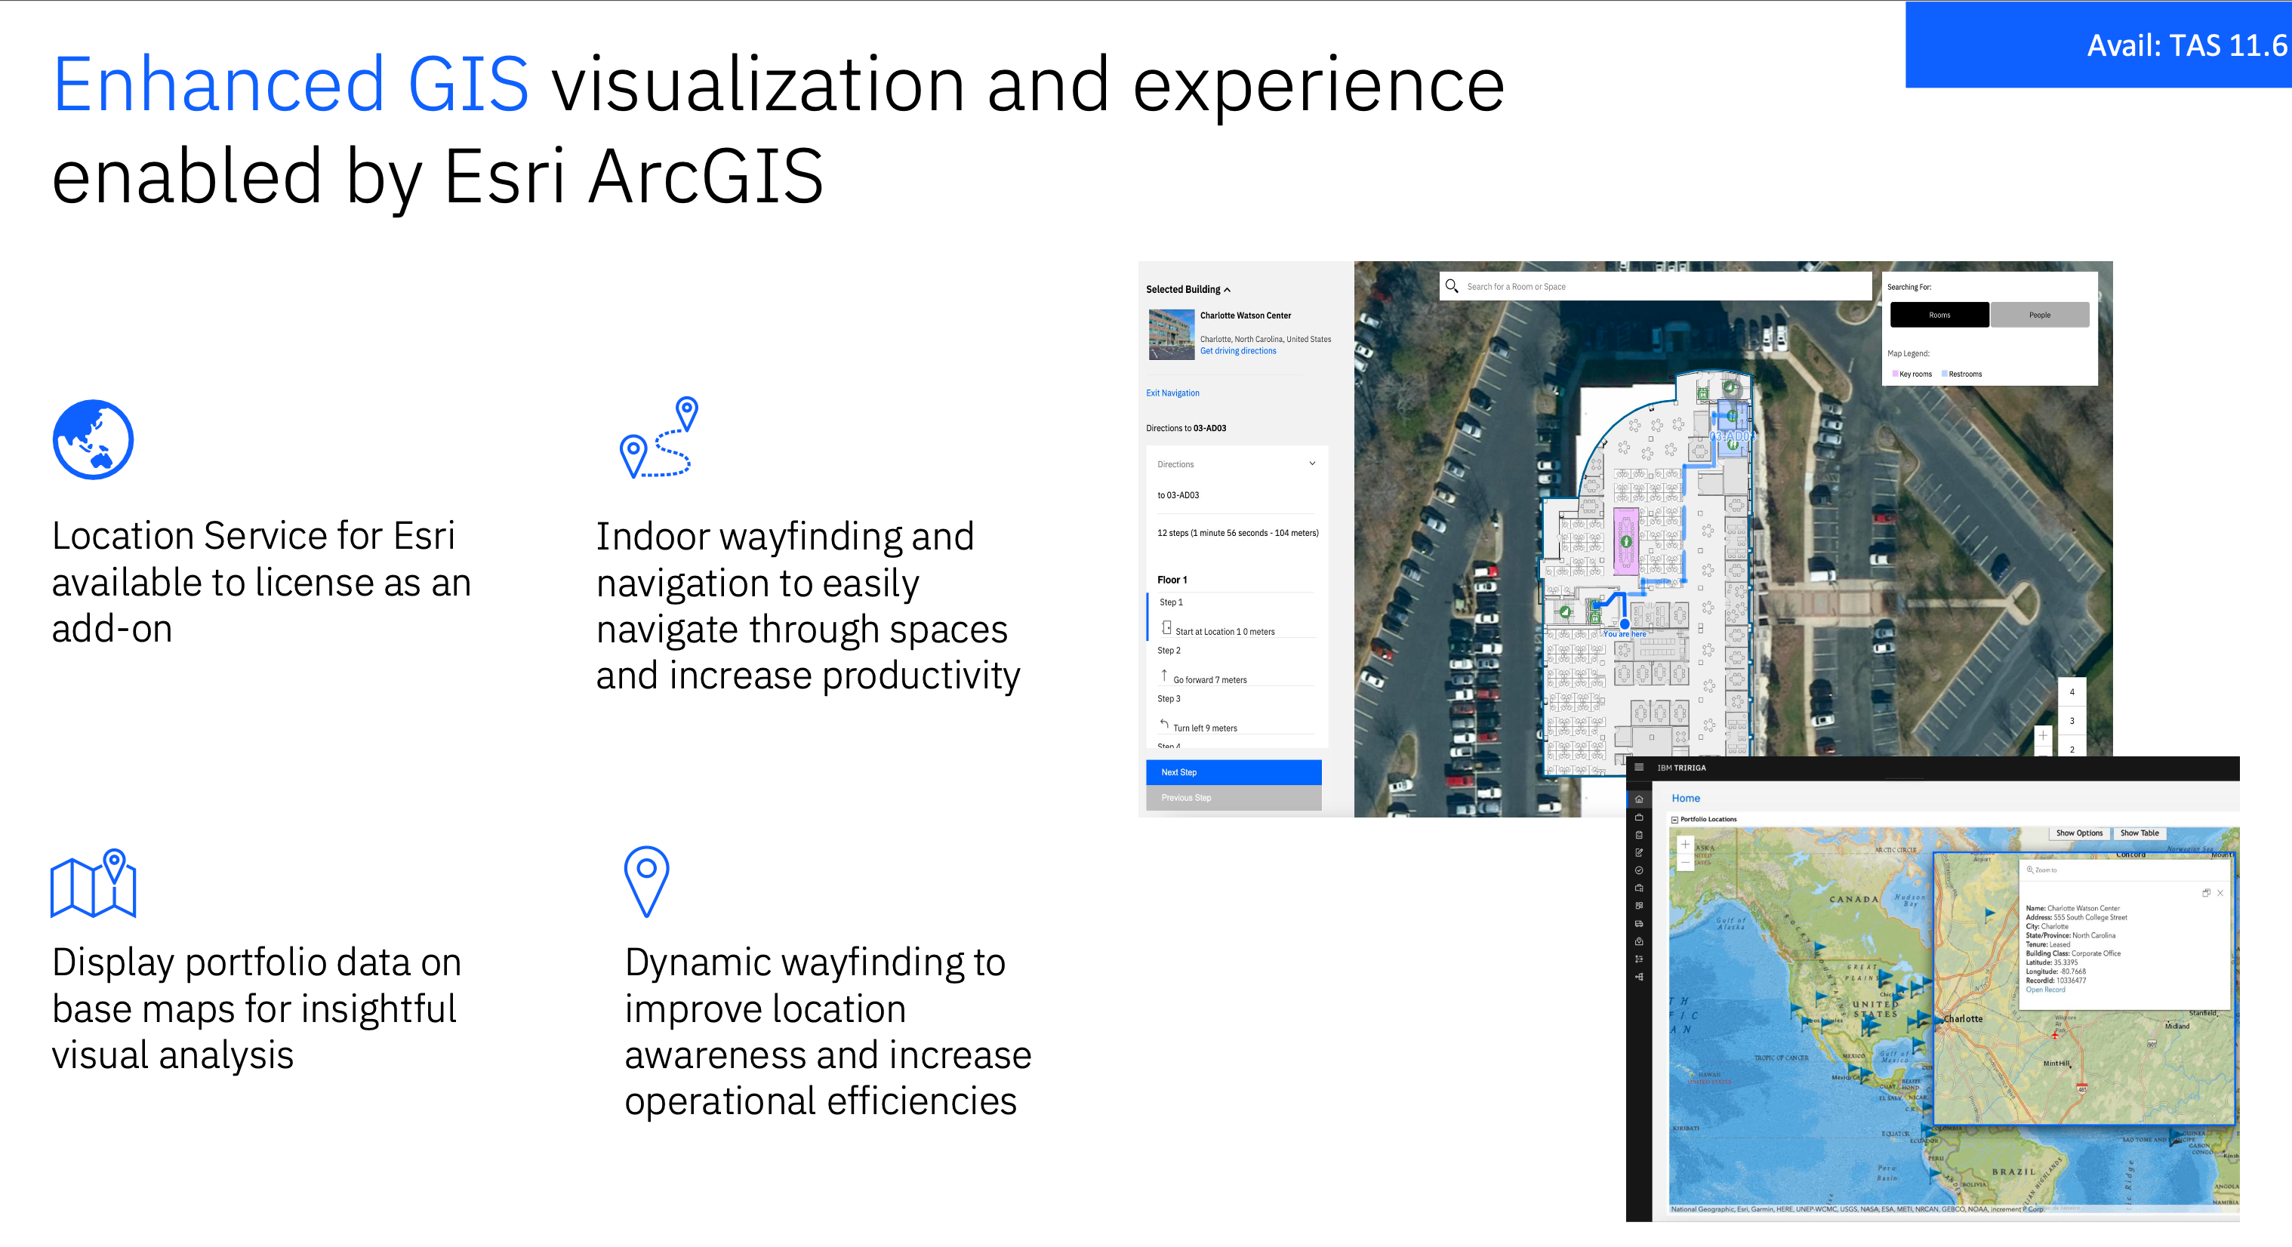

Slide 17
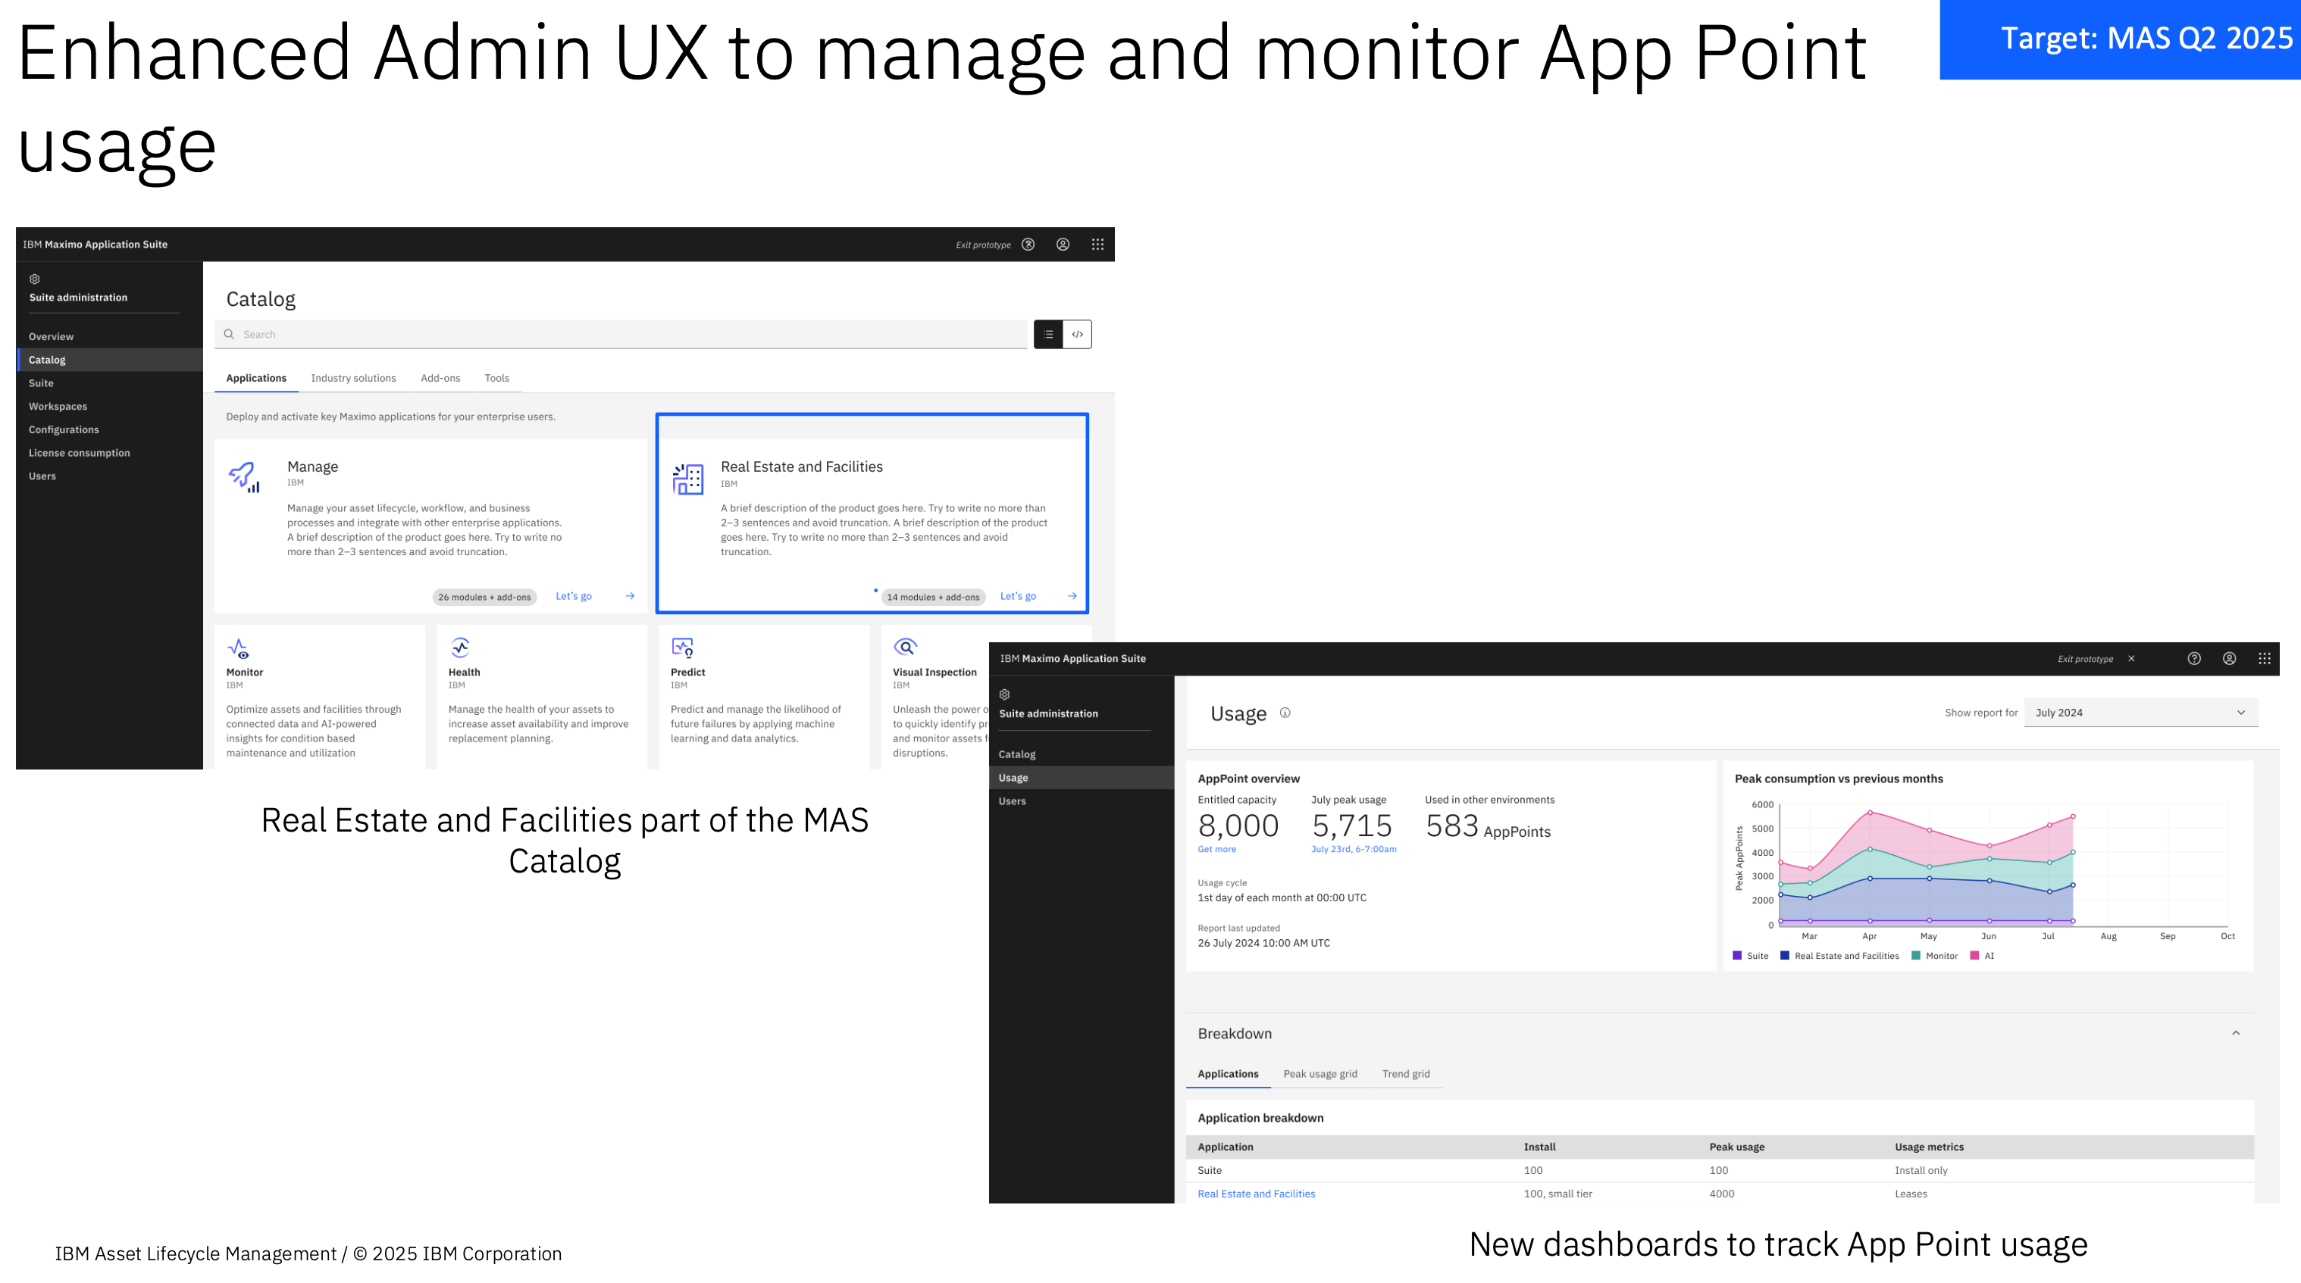

Slide 18
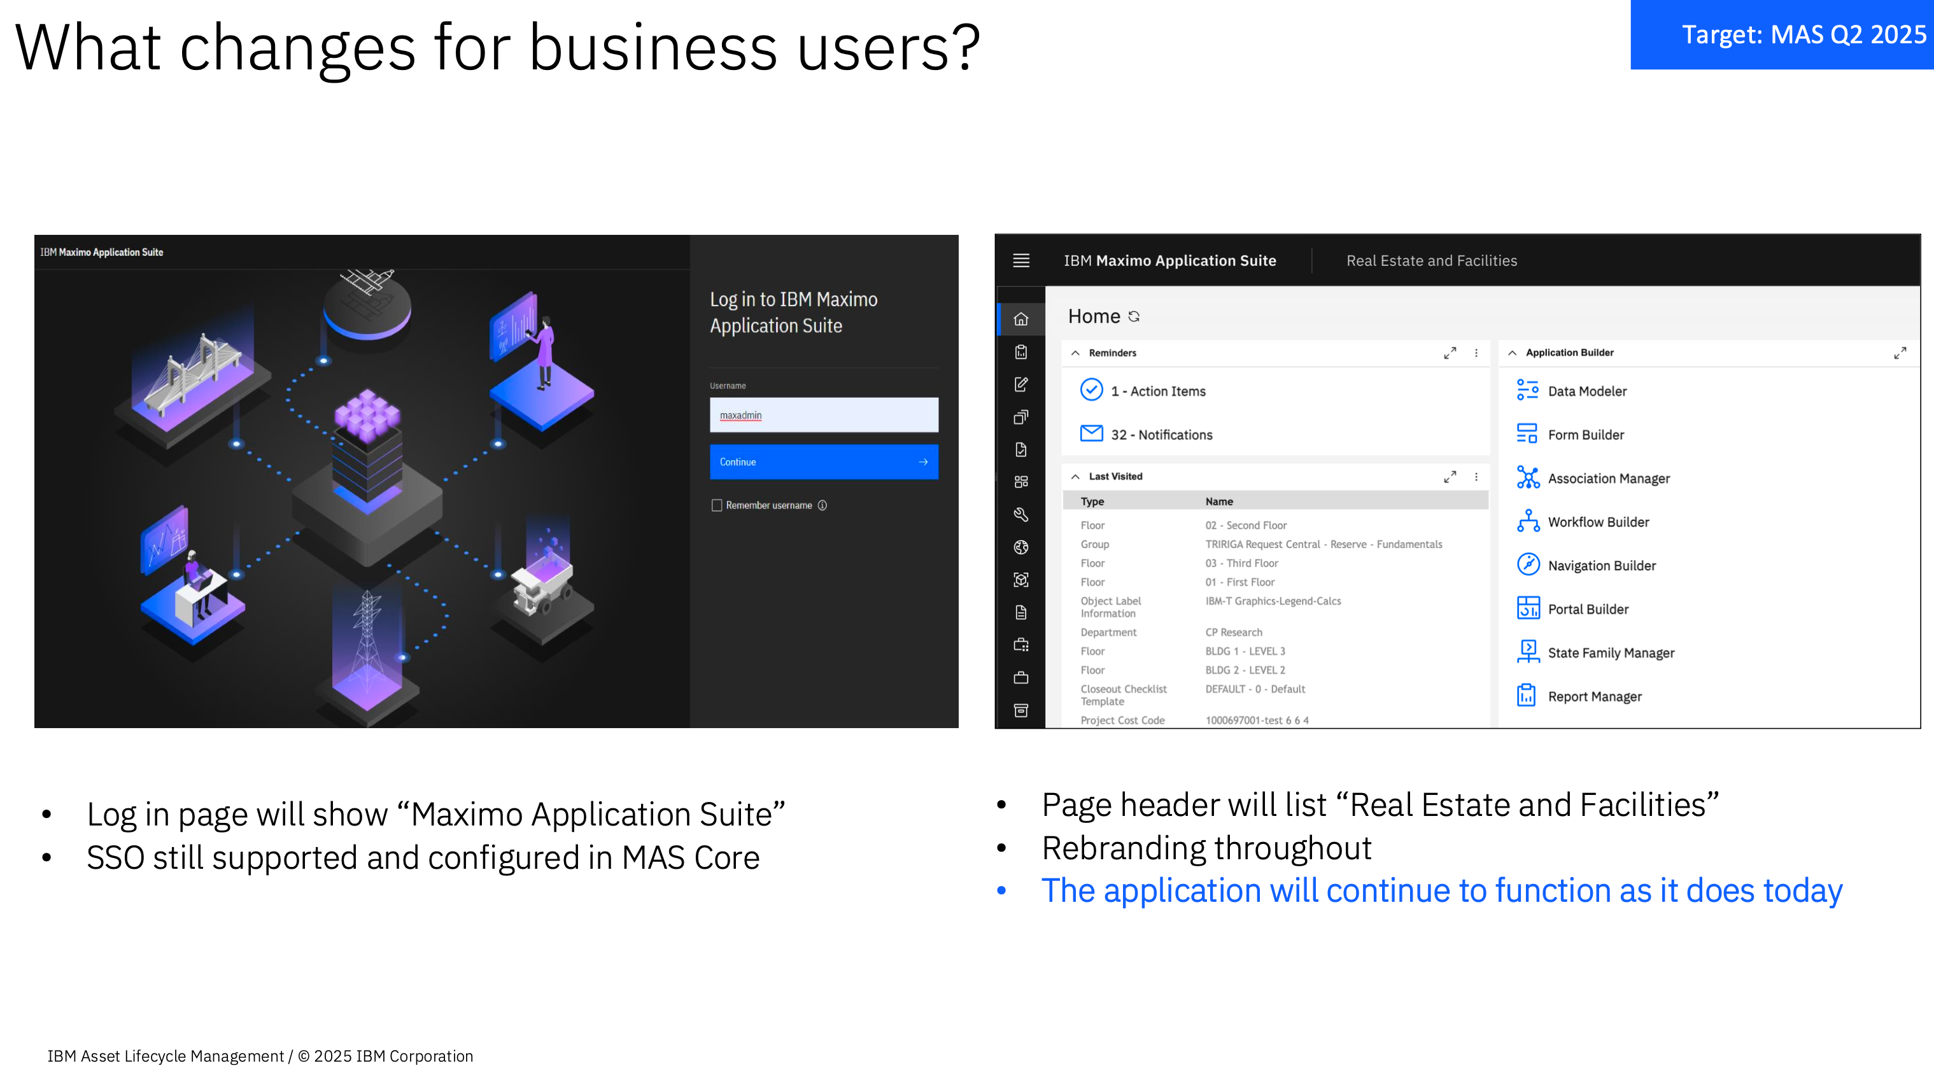

Slide 19
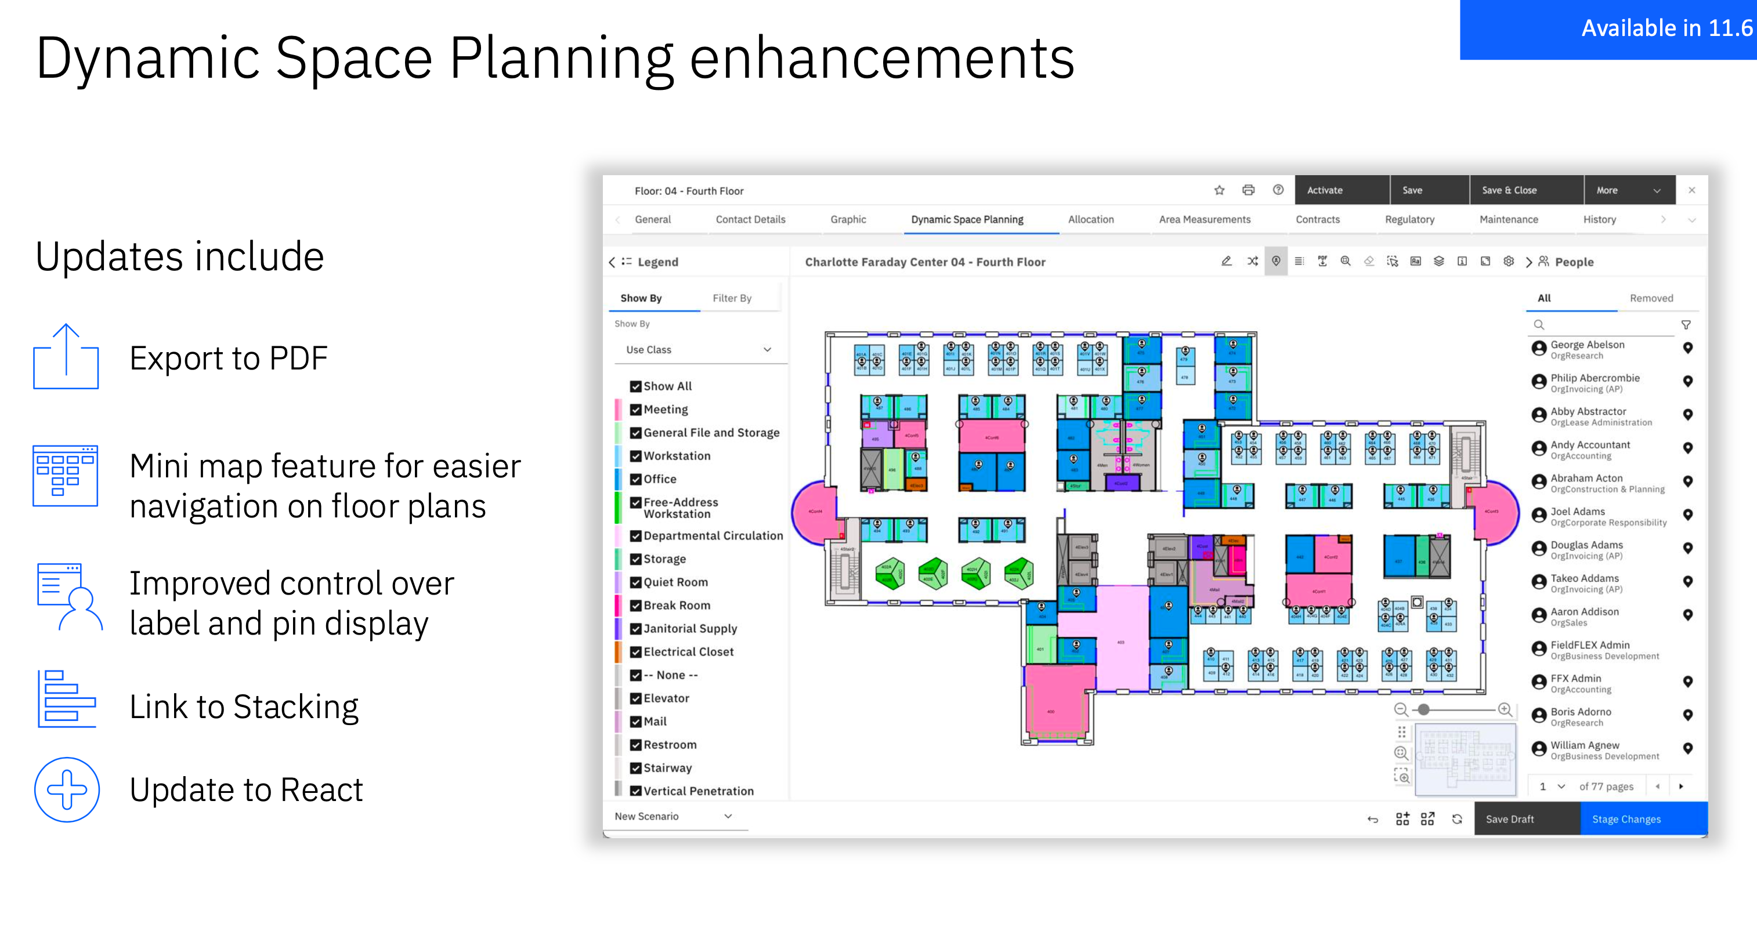

Slide 20
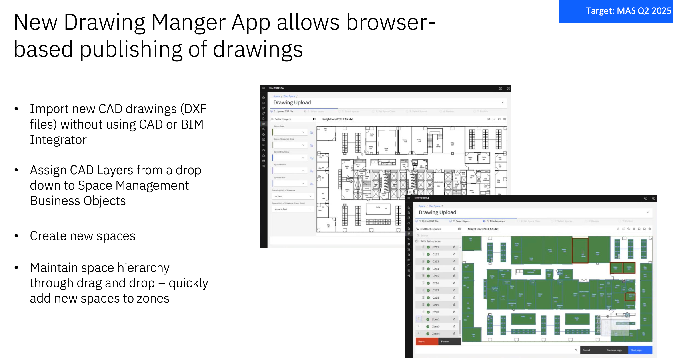

Slide 21
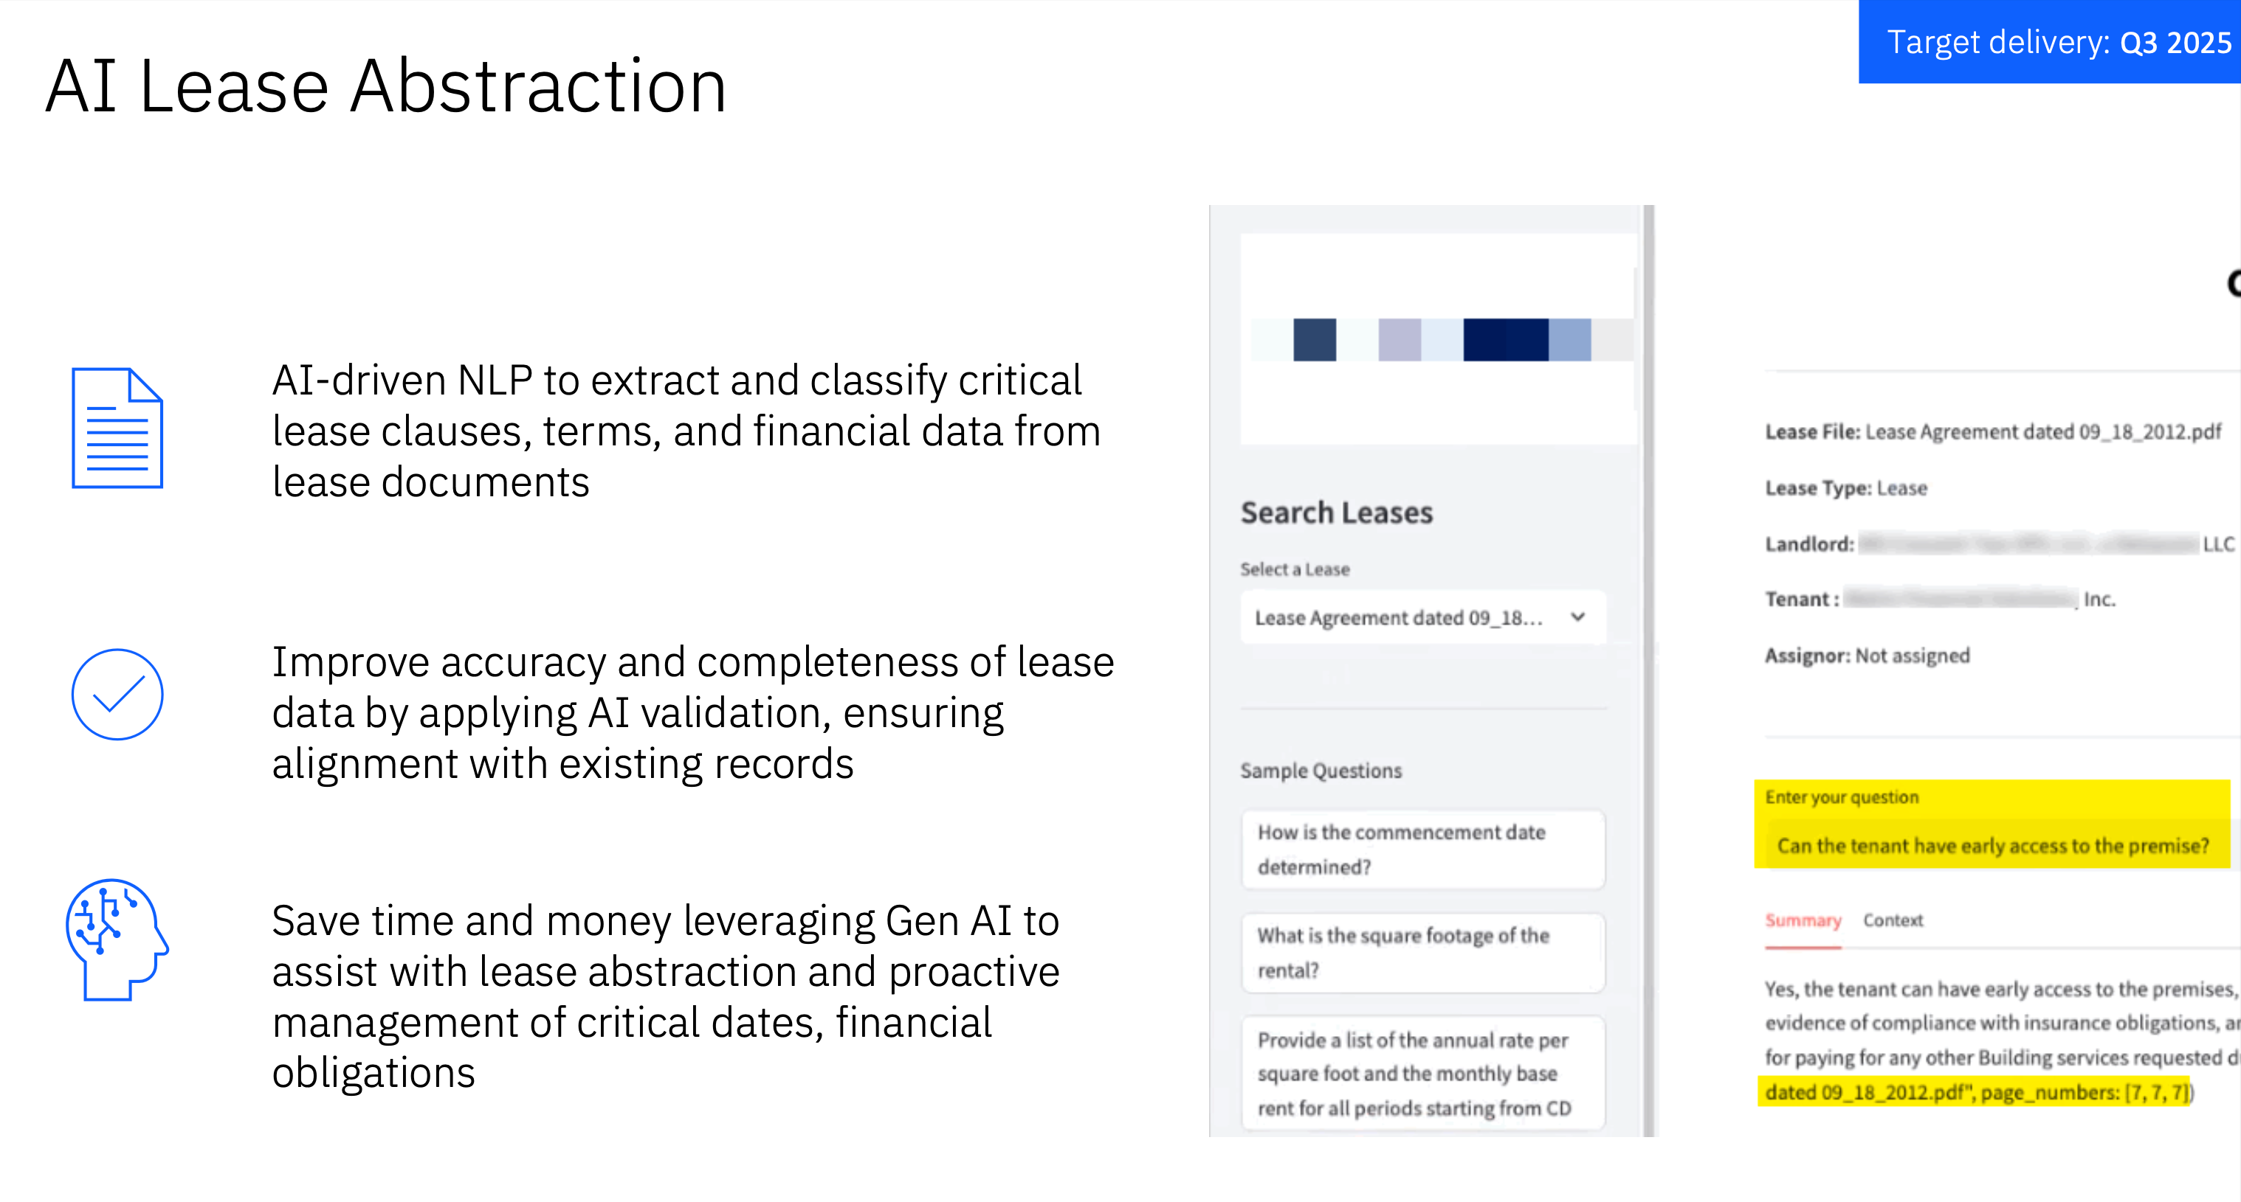

Slide 22
